Slide 1
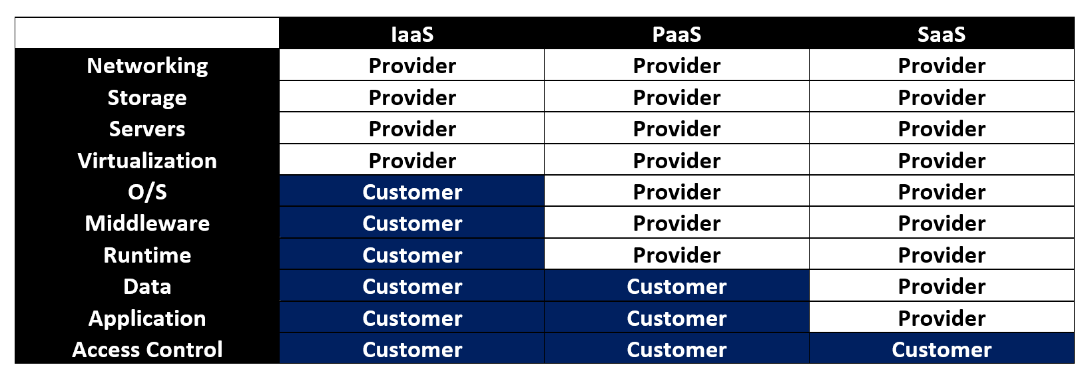
What are the Incident Handling responsibilities in Cloud ?

Slide 2
What are the Incident Handling responsibilities in Cloud ?
 | Customer | Provider
IaaS | • Has access to the system, application, and accounts IaaS • Completely responsible for detecting and responding to security incidents • Will not be able to investigate CSP controlled network and database | • Will be responsible for network and database incidents • Should provide logs related to the storage, network, and virtual machines • Responsible for all possible evidences from memory, network traffic, and media
PaaS | • Responsible for application and its security • Analyze changes to data • Can gather login and access information • Need evidences gathered by CSP for incident response process | • Enables generation of application log, storage, and secure access • Should provide the storage, network, virtual machines, runtime, and server logs
SaaS | • Has access only to the login accounts • Can collect access related data • Depends on CSP for storage, network, virtual machines, runtime, and server logs | • Completely responsible for incident handling and response process • Should collect and analyze data to detect incidents

Slide 3
What are the challenges in handling and responding to cloud security incidents?
Architecture and Identification –
Deletion in the cloud
Recovering overwritten data
Interoperability issues among CSPs
Single points of failure (but not for bad actors !!)
Detection of the malicious act
Multiple venues and geo-locations
Cloud confiscation and resource seizure

Slide 4
What are the challenges in handling and responding to cloud security incidents?
Data Collection –
Decreased access and data control
Data location
Imaging and isolating data
Data available for a limited time
Live forensics
Data integrity and evidence preservation

Slide 5
What are the challenges in handling and responding to cloud security incidents?
Analysis -
Evidence correlation
Timestamp synchronization
Use of metadata

Slide 6
What are the challenges in handling and responding to cloud security incidents?
Legal -
Missing terms in contract or SLA
Reliance on cloud providers
Physical data location
Lack of international agreements and laws

Slide 7
How do we eradicate Cloud Security incidents?
Eradication is the process of removing the compromised cloud networks and applications that can represent attacks.
Clean up the infected software
Rebuild or reconstruct compromised networks
Notify the relevant officials about the incident

